Slide 1
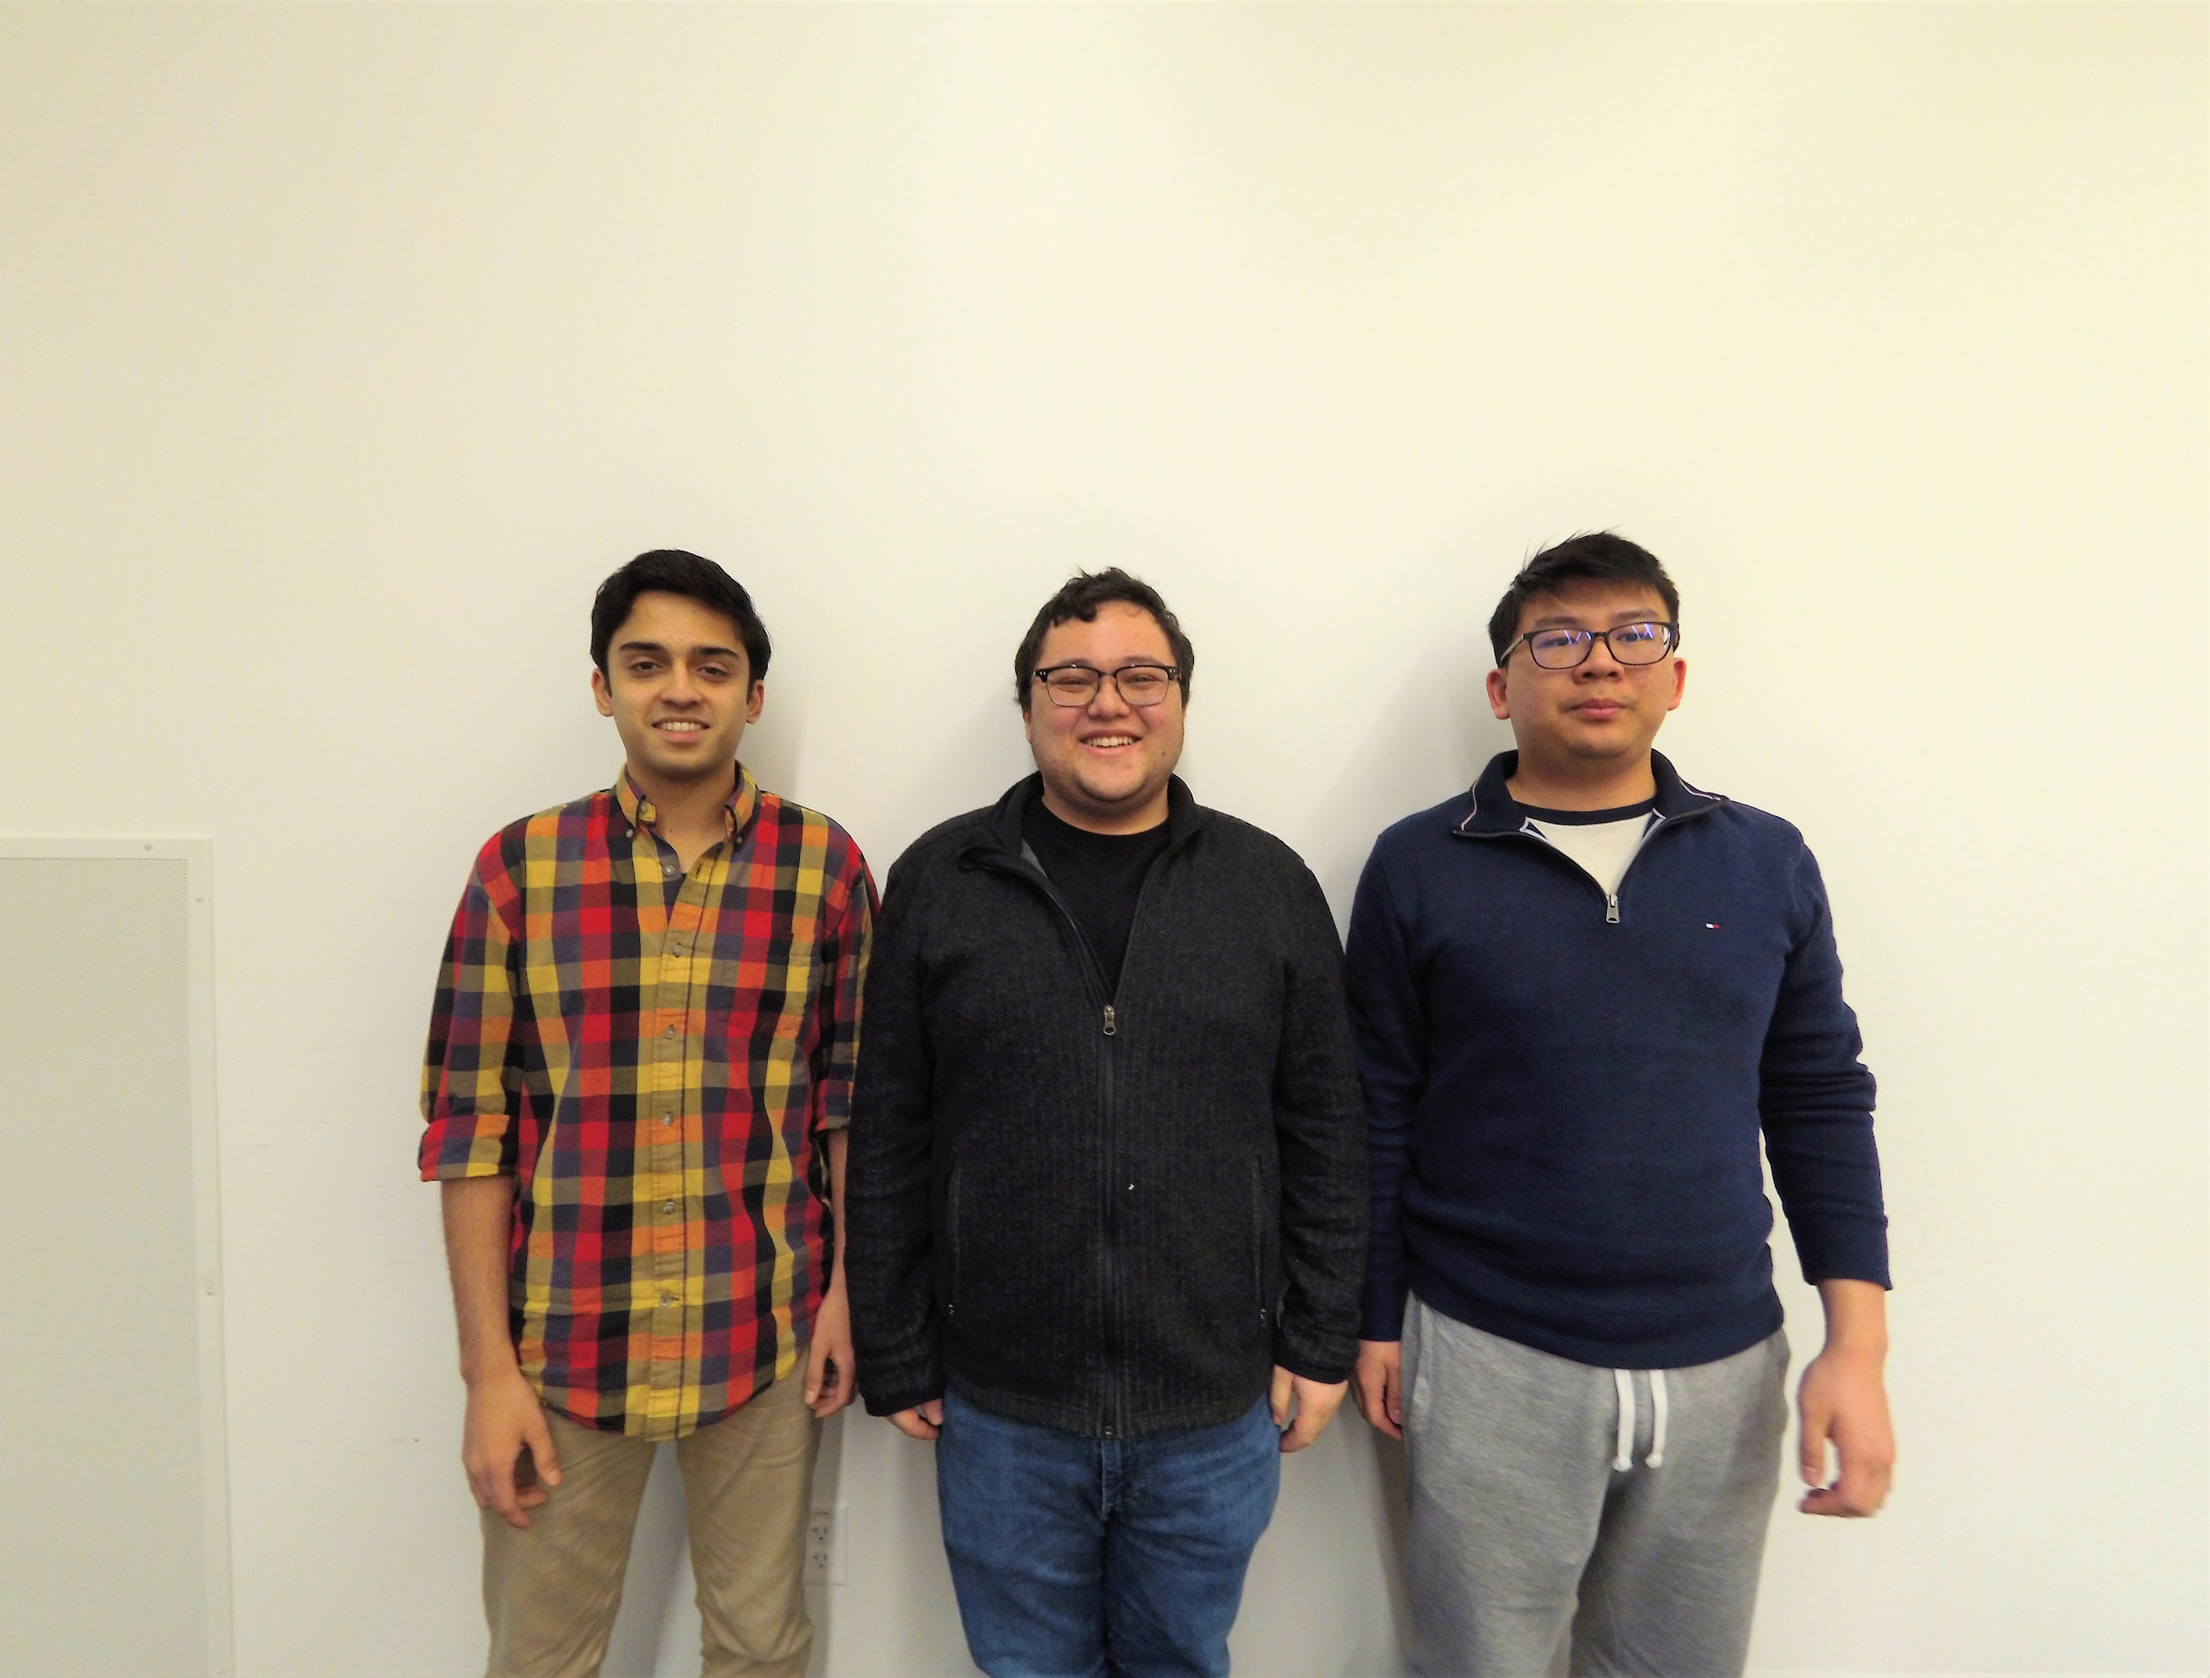
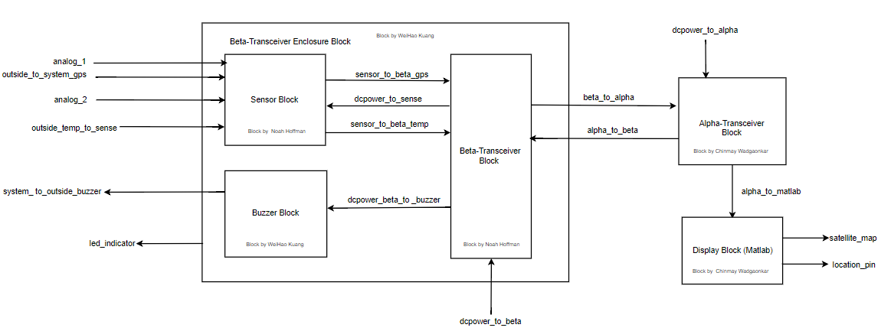
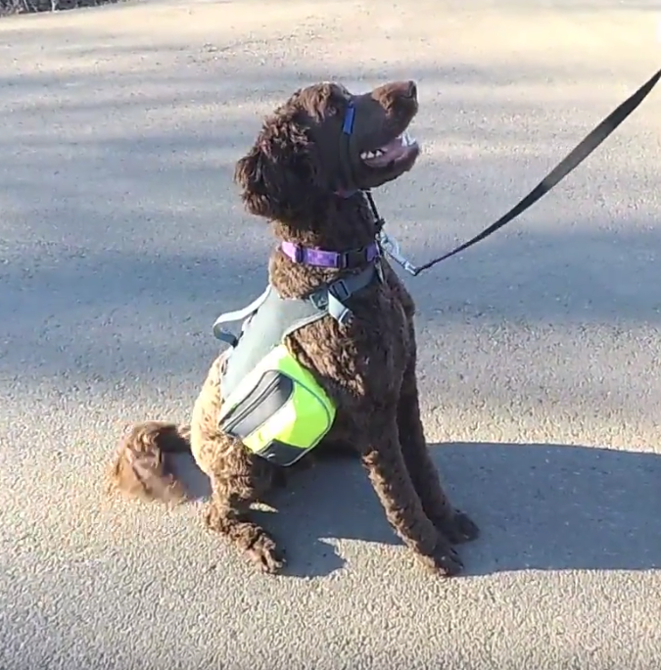
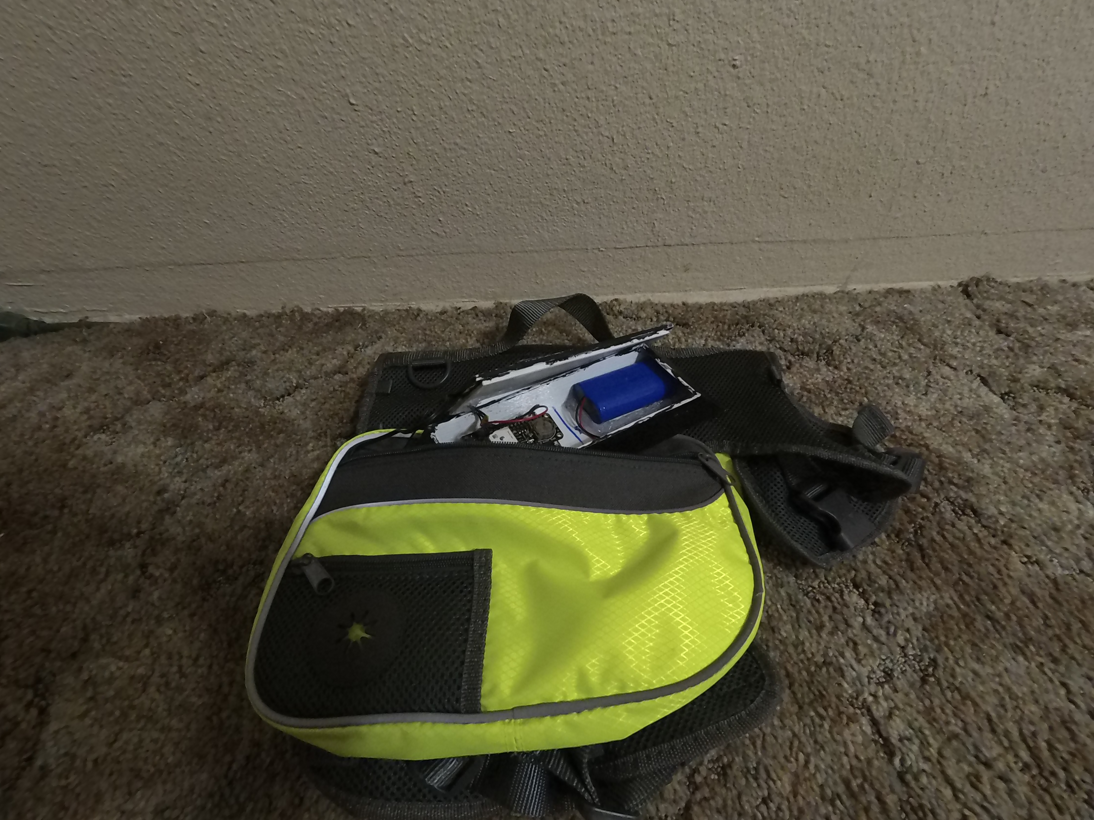
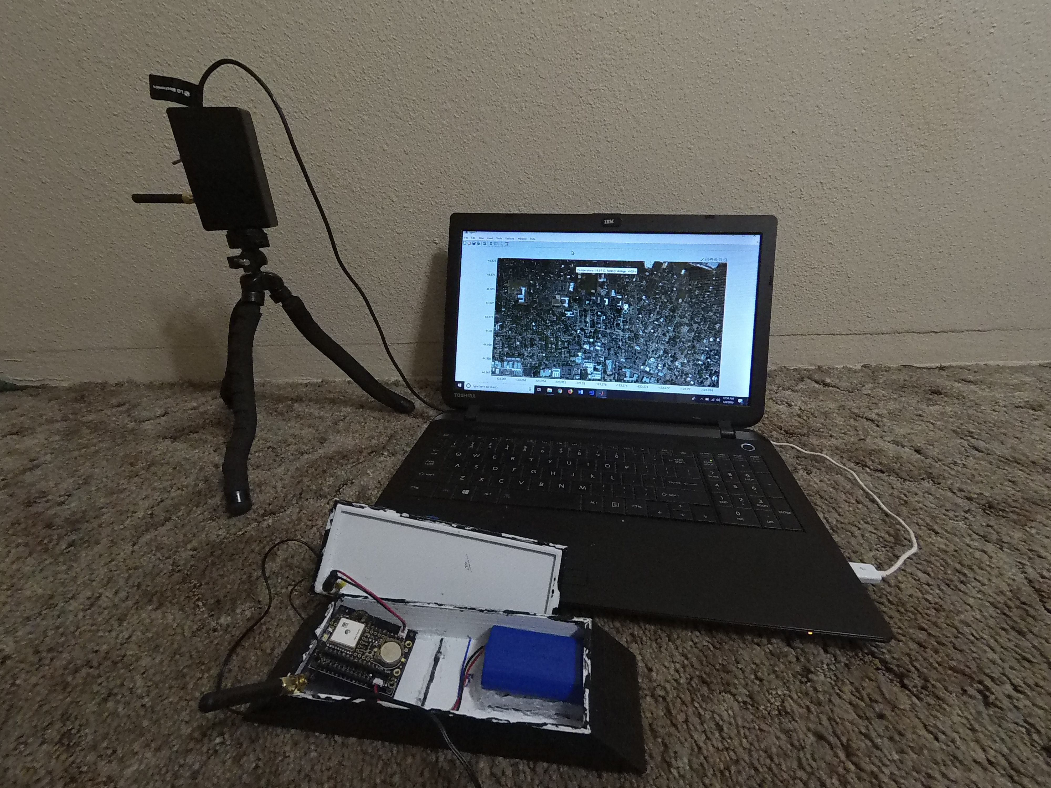
Group: 8
Unique Engineering Requirements
Telemetry
About the Team
The beta (harness) side of the system must be light enough to be wearable by a dog. Hence, the beta system can weigh up to 7 pounds or 12% of the dog’s body weight, whichever is less.
The system has two way communication. A button press by the user on the alpha side must trigger a buzzer on the beta side of the system.
Doggy tracking harness made for man’s best friend!
Fig 3: (Naming is left to right.)
Fig 1: Ollivander the Great, a 1 year-old Labradoodle, modeling the harness.
Chinmay Wadgaonkar
Alpha (MATLAB-end) Transceiver Block
MATLAB GUI Block
wadgaonc@oregonstate.edu
Noah Hoffman
System Sensor Block
Beta (Harness-end) Transceiver Block
hoffmano@oregonstate.edu
WeiHao Kuang
PCB Block
System Enclosure Block
kuangw@oregonstate.edu
Base Engineering Requirements
Fig 2: Block diagram of the entire system.
The system must log and transmit data for at least 12 hours on a single charge.
The system must log GPS data with at least a 10 meter accuracy and 2 analog voltages from 0.2 - 4.5V within 5% or 0.1V of real values, whichever is larger.
The system will function to all other requirements while: Being submerged to 1 cm of depth for one second, operating at -10°C, operating above 85°C, and after being dropped on concrete from 3 feet at least 5 times.
The system must be able to transmit its measurements at least 0.5 miles with at least 95% of the packets being received by the alpha system over an hour.
The system must display data in Matlab, with a professional looking overlay of a satellite map image.
How the system works
development
This telemetry device displays the current GPS location, the temperature, and the battery voltage of the beta transceiver, which is embedded in a dog harness, on an elegant, user-friendly MATLAB GUI that supports two way communication. The system utilizes Long Range (LoRa) as the communication protocol between the two transceivers.
Key features:
Designed for active dogs with comfort and reliability in mind.
Temperature and Battery Voltage Sensing and Realtime GPS Location.
Shock-proof & water-resistant system enclosure.
Audible customizable buzzer on the beta (harness) transceiver that can be used to train the dog from a distance.
From design to assembly, our project took 8 and a half weeks to complete. Most of our time was spent perfecting the alpha (MATLAB) and the beta (Harness) transceivers. We also focused on the development of the PCB so that we could minimize the PCB size, thus reducing the weight of the full system.
One of the difficulties that came up during the development process was getting a reliable connection between the two transceivers while using homemade wire antennas. This issue was resolved by incorporating pre-made antennas that were matched to the operating frequency(915 Hz) of the wireless LoRa modules.
Another issue we faced was making the enclosure water-resistant while still utilizing external sensors. To solve this issue we utilized silicone sealant and a solid friction seal in the 3D printed enclosure.
Our complete system is able to reliably transmit and receive data up to 0.7 miles. The system enclosure is completely water-resistant and shock-resistant while still being light and comfortable for the dog. The MATLAB GUI presents all pertinent information in a user-friendly format.
The buzzer though faint is audible from the outside and triggerable from the alpha transceiver through two way communication between the two LoRa modules.
Fig 4: Beta transceiver fits in the pocket of doggy harness.
Future Developments
Incorporate an even more reliable and visually appealing enclosure made from sturdier materials.
Implement and design our own LoRa module on a smaller and more efficient micro-controller to further cut back on cost and size.
Incorporate multiple Beta transceivers to be able to track and interact with multiple dogs from a distance.
Implement multiple unique buzzer frequencies to train the dog with multiple commands.
Fig 5: Entire system setup with alpha transceiver and display (top) and bare beta transceiver (bottom).

